Slide 1

Hyperparameter Tuning with Python

Slide 2
Outline
What are hyperparameters?
Why optimizing them?
Cross Validation
Tuning penalized regression
Tuning K-nearest neighbors
Tuning K-means clustering
Tuning Random Forest

Slide 3
What are hyperparameters?
Hyperparameters are parameters whose values are specified by the modeller in advance (before training the model)
In contrast: usual model parameter values are derived (learned) via model training
E.g. coefficients of regression models
Sample of hyperparameters:
Lambda (alpha in python), the regularization parameter in Ridge/LASSO
K (number of clusters) in K-Means algorithm, and K-Nearest Neighbors
Number of ensemble decision trees in Random Forest model
Etc

Slide 4
Why Optimizing Hyperparameters?
01
02
To Avoid Overfitting
To Get Best of The Best Model
The most complex model is not always better
Our ultimate goal is to have a model that performs well on unseen data (test data)
Good data scientist NEVER build only a single model
Build multiple models instead!
And choose the best one

Slide 5
Recall: Our Strategy to Train Penalized Regression
All Data
Training
Validation
Testing
Train multiple models with different lambdas
Model 1 (lambda = 0.1)
Model 2 (lambda = 1)
Model 3 (lambda = 10)
Choose the best lambda
Lambda = 1 is best (Model 2)
Evaluate the best model
Report metrics of Model 2

Slide 6
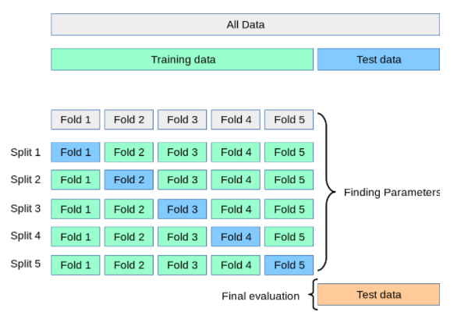
Cross Validation
Only divide full data into two sets
For each split, allocate 4 folds as real training data and leave 1 fold as validation set
Train and validate model in each split
Notes:
Training data dibagi jadi 5 lipatan
Dari 5 lipatan ini kita bentuk 5 split, yaitu kombinasi berbeda dari 4 fold menjadi training data, 1 fold sisanya menjadi validation set
Kita train model untuk setiap split (5 kali train)
Setelah kelima training selesai, kita evaluasi pada test data

Slide 7
K-Fold Cross Validation
We separate the training data to become K parts (folds) with the same size
For each split, we train the model on all K-1 folds (green folds)
And validate the model on the last fold that remains (blue fold)
i.e. compute evaluation metrics on the blue fold (can be seen as validation data)
After done with all splits (combination of K-1 training parts and 1 validation part)
Average out all of K evaluation metrics to become the final metric
As basis to choose the best hyperparameter
What number is K?
5 is a good default
3 is minimum, 10 when your machine allows

Slide 8
+
More robust results
By validating the trained model multiple times, we will get more stable results on the model performance
And hence the correctness of the optimal hyperparameters chosen
+
Help maximizing data size value
Cross validation is extremely helpful when our dataset is not too big
i.e. < 100K rows
In a way, it gives us a free validation data
+/- of Cross Validation
-
Heavier computation
Since it takes K times training processes to finish one complete round of model training with a specific hyperparameter value

Slide 9


Slide 10
Penalized Regression
We will tune lambda, which regulates the level of regularization of the regression
01
02
Ridge
LASSO
Lambda effect to the model coefficients
Coeff will become smaller (larger lambda == smaller coeff)
Yet they all never be exactly zero
Lambda effect to the model coefficients
Coeff will become smaller (larger lambda == smaller coeff)
Some of them will be exactly zero (eliminated from the model)

Slide 11
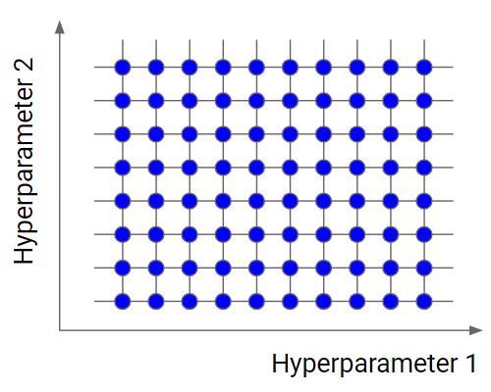
We’ll use GridSearchCV function
GridSearchCV is a function from sklearn library to do hyperparameter tuning based on Cross Validation
Essentially, what it does is to try every combination of the specified hyperparameter values
Example on the left:
There will be 5 times the program will do K-fold cross validation
ƛ
0.01 0.1 1 5 10

Slide 12
If > 1 types of hyperparameter
GridSearchCV will try every combination pair of the specified hyperparameter values
Example on the left:
Hyperparameter 1: 10 distinct values
Hyperparameter 2: 8 distinct values
So there are 10 x 8 = 80 times K-fold cross validation!

Slide 13
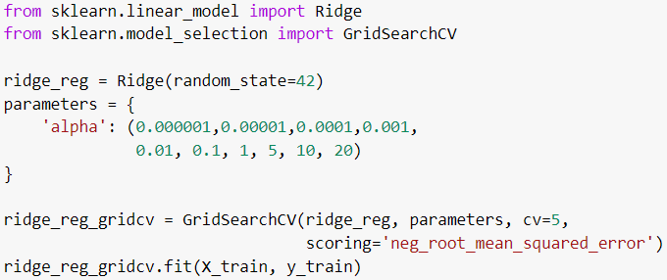
Tuning Penalized Regression
For Ridge (LASSO is quite similar)
ensure reproducibility
tested lambda values
5-fold CV
Evaluation metric used

Slide 14

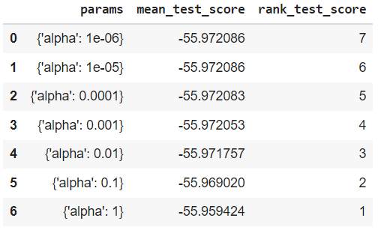
Tuning Penalized Regression
The results
Best model

Slide 15
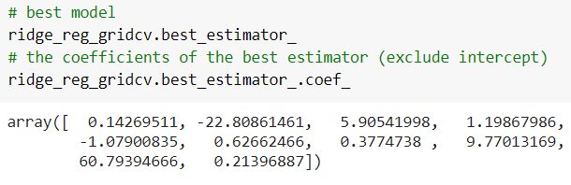

Tuning Penalized Regression
The best model obtained

Slide 16


Hands-On
Open today’s Jupyter notebook on your Google Colab!
Make sure you have uploaded the required CSV files to your google drive
Remember the file path!

Slide 18
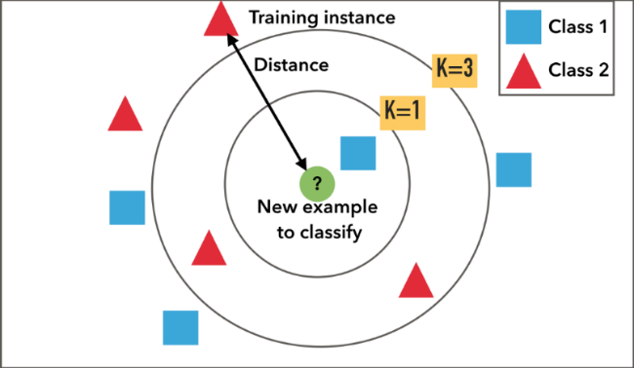
K-Nearest Neighbors
Classifier
Recall: KNN classifies the label of a data point based on the majority label of its K nearest neighbors
Naturally, we can tune K
i.e. the number of neighbors we want to look at
Pattern
Smaller K: higher variance
more likely to overfitting
Vice versa

Slide 19
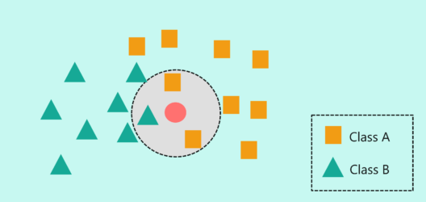
Intuition
K Nearest
Neighbor
If K = 3, then we only check 3 of its nearest neighbors.
Since out of 3 of its nearest neighbors, 2 are Class A, and 1 is Class B, we will predict it to be Class A.

Slide 20
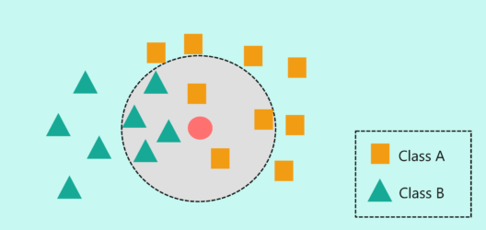
Intuition
K Nearest
Neighbor
If K = 7, then we only check 7 of its nearest neighbors.
Now the situation changes, 4 Class B vs 3 Class A.
Then in this case, the circle belongs to Class B

Slide 21
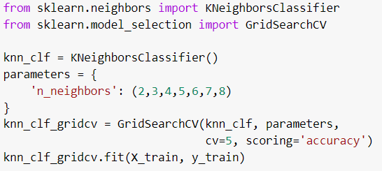
Tuning KNN
tested number of considered neighbors
Evaluation metric used
(Note: can be adjusted based on condition)

Slide 22
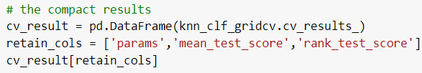
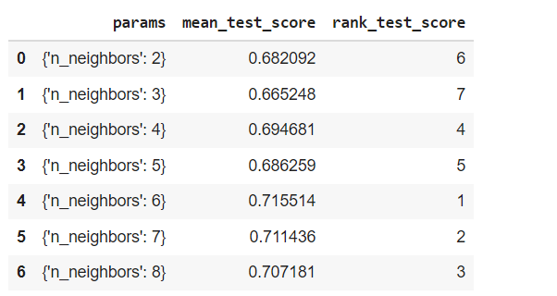
Tuning KNN
The results
Best model

Slide 23
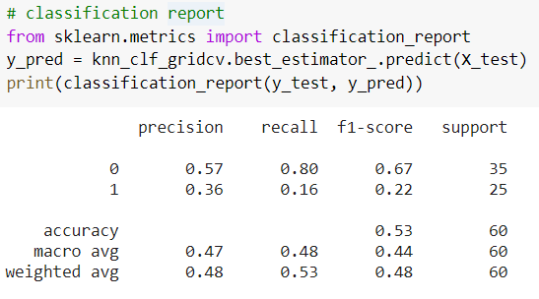
Tuning KNN
Evaluating the best model obtained

Slide 24
Hands-On
Open today’s Jupyter notebook on your Google Colab!
Make sure you have uploaded the required CSV files to your google drive
Remember the file path!

Slide 26
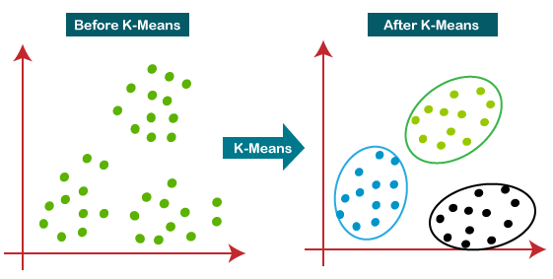
K-Means Clustering
Recall: K Means algorithm is a unsupervised model to find K similar groups in data
The relevant metric is Sum of Squared Error
The “error” refers to the deviation/distance between a data point and its centroid.
Naturally, we can tune K
i.e. the number of clusters we want to have
x
x
x

Slide 27
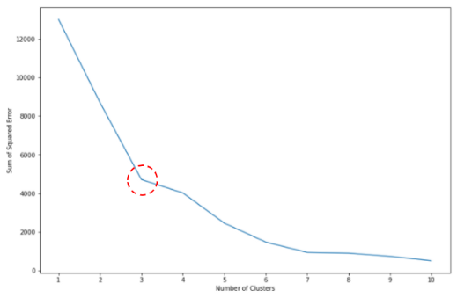
Tuning K-Means Algorithm
NO, we won’t use GridSearchCV
Instead, we will use the Elbow Method
We plot the sum of squared errors (SSE) for various K values
Choose the K value at which the SSE decline slopes change significantly (forming an “elbow” shape)

Slide 28
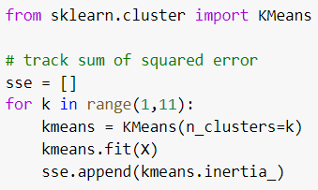
Tuning K-Means Algorithm
tested k = [1,2,3,..., 10]
Sum of Squared Error

Slide 29
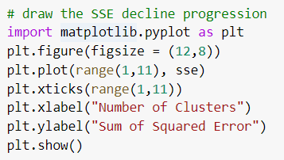
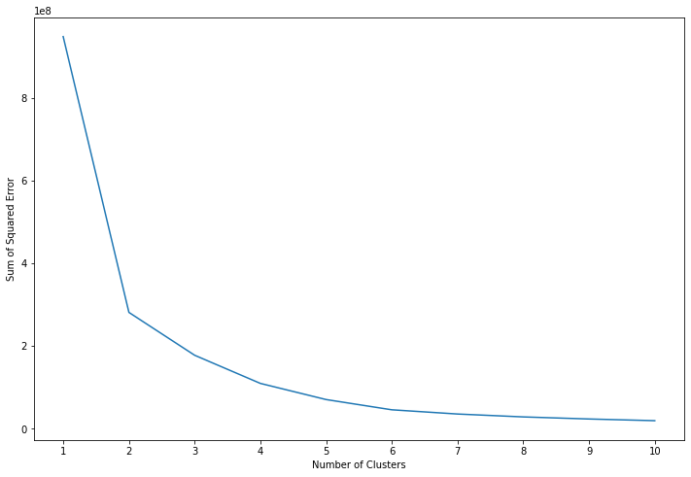
Tuning K-Means Algorithm

Slide 30
Hands-On
Open today’s Jupyter notebook on your Google Colab!
Make sure you have uploaded the required CSV files to your google drive
Remember the file path!

Slide 32
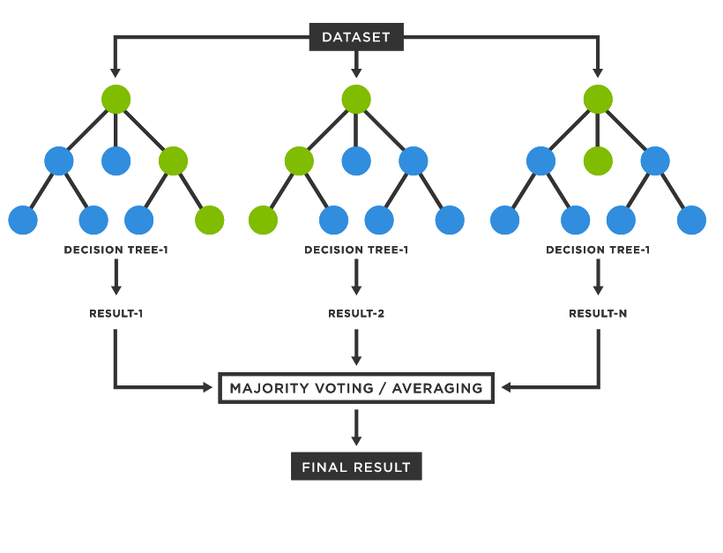
Random Forest
Recall: Random Forest is a group of decision trees that predict target variable by taking majority votes among them
There are several things that can be optimized:
number of trees in the “forest”
max tree depth
max number of leafs for each tree
etc

Slide 33
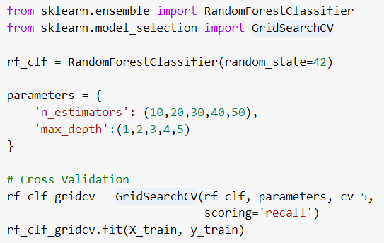
Tuning Random Forest
Hyperparam 1: number of trees
Hyperparam 2: max tree depth
Evaluation metric used

Slide 34
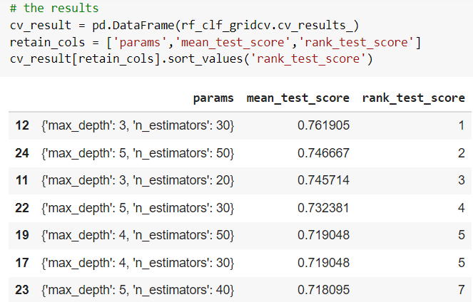
Tuning Random Forest
The results
Sorted from the best model

Slide 35
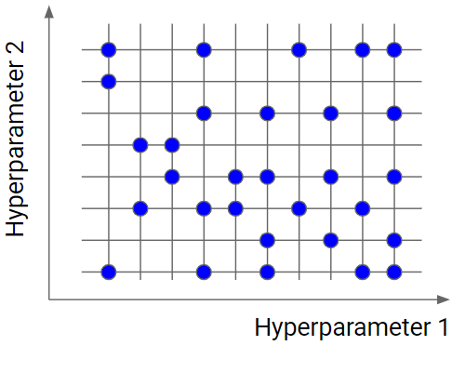
RandomizedSearchCV
For faster training duration
There are 5 x 5 = 25 combinations!
Can be long to run (compute)!
In such cases, we may use RandomizedSearchCV
It only considers a subset of random combinations of hyperparameter values

Slide 36
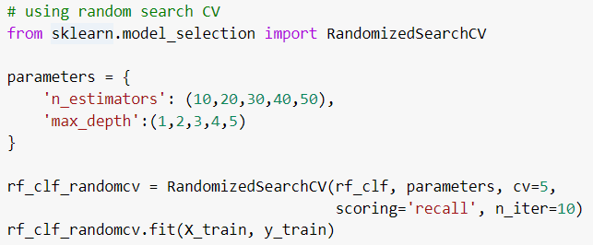
Tuning Random Forest
Number of pairs tested

Slide 37
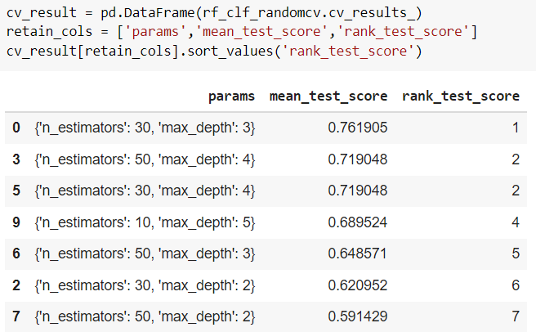
Tuning Random Forest
The results using RandomizedSearchCV
Same as GridSearchCV
Note that this is NOT always the case

Slide 38
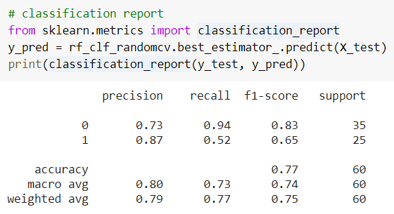
Tuning Random Forest
Evaluating the best model obtained
Better than KNN

Slide 39
Hands-On
Open today’s Jupyter notebook on your Google Colab!
Make sure you have uploaded the required CSV files to your google drive
Remember the file path!

Slide 41
Bayesian Optimization - Optuna
Optuna adalah library Python open-source untuk hyperparameter optimization yang otomatis, efisien, dan flexible. Dikembangkan oleh Preferred Networks.
Cara Kerja Optuna (Konsep Inti)
1.Trial
Satu kali percobaan Optuna dalam menguji satu kombinasi hyperparameter disebut Trial.
2. Study
Kumpulan dari trial-trial tersebut disebut Study. Setiap study bertujuan untuk minimize atau maximize nilai objective (misalnya: error, loss, atau akurasi).
3. Sampler
Optuna menggunakan sampler untuk memilih kombinasi parameter yang patut dicoba. Secara default, menggunakan : TPE (Tree-structured Parzen Estimator): model probabilistik yang belajar dari trial sebelumnya, lalu menebak kombinasi parameter selanjutnya yang menjanjikan.

Slide 42
Bayesian Optimization - Optuna
Simulasi Cara Kerja Optuna (Secara Intuitif)
Analogi: Cari Resep Kue Terenak
Misalnya dengan 3 parameter:
Jumlah gula (g): 100–300 gram
Suhu oven (s): 160–220 derajat
Waktu panggang (t): 20–60 menit
💡 Grid Search:
Mencoba semua kombinasi, boros waktu dan bahan.
💡 Random Search:
Mencoba kombinasi acak. Bisa hoki, bisa zonk.
💡 Optuna:
Melakukan beberapa kali percobaan (trial awal)
Mencatat hasil setiap percobaan
Menganalisis percobaan yang memiliki performa baik
mencari kombinasi yang mirip dari hasil analisis
Ulangi hingga menemukan kombinasi terbaik
Optuna akan belajar dari hasil sebelumnya dan mengarahkan pencarian ke arah yang lebih menjanjikan (eksploitasi), sambil sesekali coba hal baru (eksplorasi).

Slide 43
TPE (Tree-structured Parzen Estimator)
Trial 1: x = -6.2 → f(x) = 88
Trial 2: x = 5.1 → f(x) = 4.41
Trial 3: x = 2.8 → f(x) = 1.04 ← promising
Trial 4: x = 3.1 → f(x) = 1.01 ← even better!
Trial 5: x = 2.95 → f(x) = 1.002 ← hampir best
Trial 6: x = 3.0 → f(x) = 1.000 ← optimal!

Slide 44
TPE (Tree-structured Parzen Estimator)
Kumpulkan Trial-Result
TPE menyimpan semua kombinasi parameter dan hasilnya.
Pisahkan Trial
Trial dibagi jadi 2 kelompok
Good (L) → trial dengan loss di bawah threshold (misal 20% terbaik)
Bad (G) → sisanya
Bangun 2 Distribusi Probabilitas
Buat model probabilitas parameter berdasarkan:
l(x) = P(x | y < threshold) → parameter yang muncul di trial bagus
g(x) = P(x | y ≥ threshold) → parameter yang muncul di trial jelek
Pilih Parameter Parameter baru diambil dari distribusi l(x) yang memaksimalkan EI:
EI(x) ∝ l(x) / g(x)

Slide 45
TPE (Tree-structured Parzen Estimator)
Analogi Sederhana: Cari Toko Kue Terbaik
Mencari toko kue terbaik di kota konoha:
kumpulkan review dari 100 toko kue.
bagi menjadi 2 kelompok:
20 toko dengan review terbaik (kelompok L)
80 sisanya (kelompok G)
analisis karakteristik grup L :
Harga: 30–50 ribu
Lokasi: di tengah kota
Tipe kue: cheesecake
analisis karakteristik grup G (review jelek):
Harga: 15–25 ribu
Lokasi: pinggiran kota
Tipe kue: bolu kering
Maka, eksplorasi toko baru yang harganya 40 ribu, di pusat kota, jual cheesecake.

Slide 46

Assignment
What to submit? Google colab link (don’t forget to share access to me: arifromadhan19@gmail.com)
Format notebook name: HW_HPTUNING_<YOUR COMPLETE NAME>

Slide 47

Problem
Load churn.csv as Data Frame
10 point Student mampu melakukan pembersihan data sebelum pemodelan
10 point Student mampu membagi dataset untuk training, validasi, dan testing
10 point Student mampu mengidentifikasi fitur yang redundant dan mencegah multicollinearity
15 point Student mampu mentransformasi fitur kategorikal agar dapat digunakan dalam model
10 point Student mampu memilih metrik yang sesuai untuk evaluasi model
30 point Student mampu memilih hyperparameter terbaik menggunakan cross-validation
10 point Student mampu melakukan evaluasi model dan menginterpretasikan hasilnya

Slide 48
Thank you

